Slide 1
θ₈
The full graph
H
θ₈
= violates assumption
Y₁
Y₂
= “irreversible”
θ₃
θ₇
θ₃
= “indirect path”
θ₂
θ₅
X₁
X₂
θ₅
= “direct path”
θ₂
θ₁₁
θ₉
θ₆
θ₉
θ₁
θ₁
C₁
C₂
θ₉
Z
θ₄
θ₆
X₁ C₂
Y₁ X₂
H Y
Z X,Y
H Z
X₁ X₂
θ₁₀
θ₇
θ₁
C X
H X
X Y
C₁ C₂
C₂ Y
θ₈
θ₂
θ₉
θ₃
θ₁₀
θ₄
θ₁₁
θ₅

Slide 2
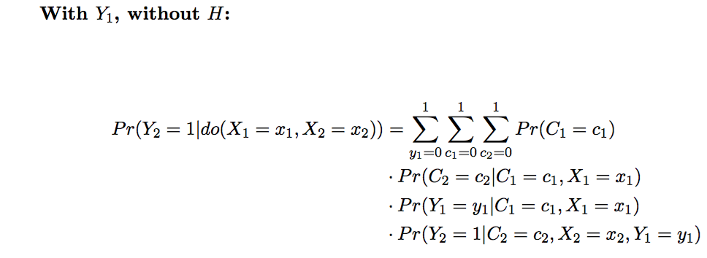
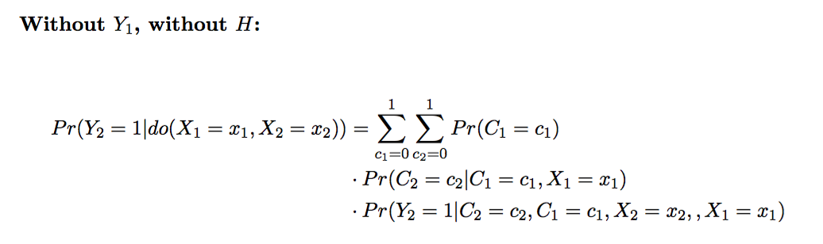
Consider models that ignore H:

Slide 3
‘True Model’
H
Y₁
Y₂
= “either or”
θ₂
= “irreversible”
θ₂
X₁
X₂
θ₁₁
θ₂ , θ₄, θ₅, θ₁₁
take values between 0 and 5.
θ₅
θ₅
θ₆
C₁
C₂
Z
θ₄
Y₁
Y₂
Y₂
X₁
X₂
X₁
X₂
C₁
C₂
C₁
C₂

Slide 4
θ₂ , θ₄, θ₅, θ₁₁
take values between 0 and 2.

Slide 5
θ₂ , θ₄, θ₅, θ₁₁
take values between 0 and 5.
There appears to be a problem if Y1 is ignored…
When θ₂=0, θ₆=0, and θ₅>0,
there is substantial inflation of type I error.

Slide 6
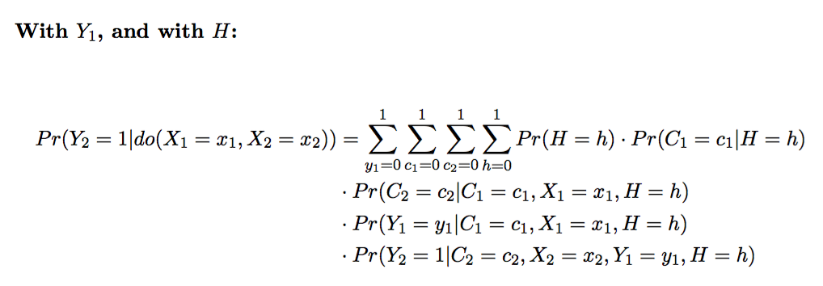
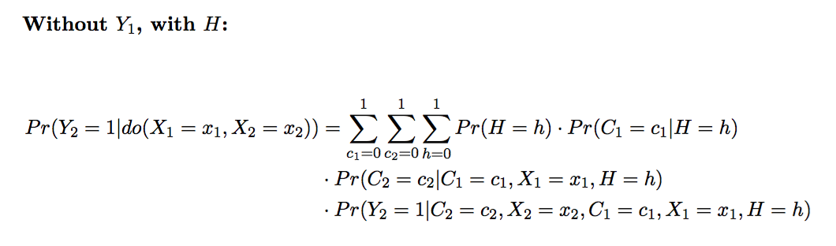
Consider models that incorporate H:

Slide 7
‘True Model’
H
Y₁
Y₂
= “either or”
θ₂
= “irreversible”
θ₂
X₁
X₂
θ₁₁
θ₅
θ₅
θ₆
C₁
C₂
Z
θ₄
H
Y₁
Y₂
H
Y₂
X₁
X₂
X₁
X₂
C₁
C₂
C₁
C₂

Slide 8
θ₂ , θ₄, θ₅, θ₁₁
take values between 0 and 2.

Slide 9
θ₂ , θ₄, θ₅, θ₁₁
take values between 0 and 5.
There appears to be a problem if Y1 is ignored…
When θ₂=0, θ₆=0, and θ₅>0,
there is substantial inflation of type I error.

Slide 12
H
Y₁
Y₂
θ₃
θ₃
θ₂
θ₂
X₁
X₂
θ₁₁
C₁
C₂
Z

Slide 15
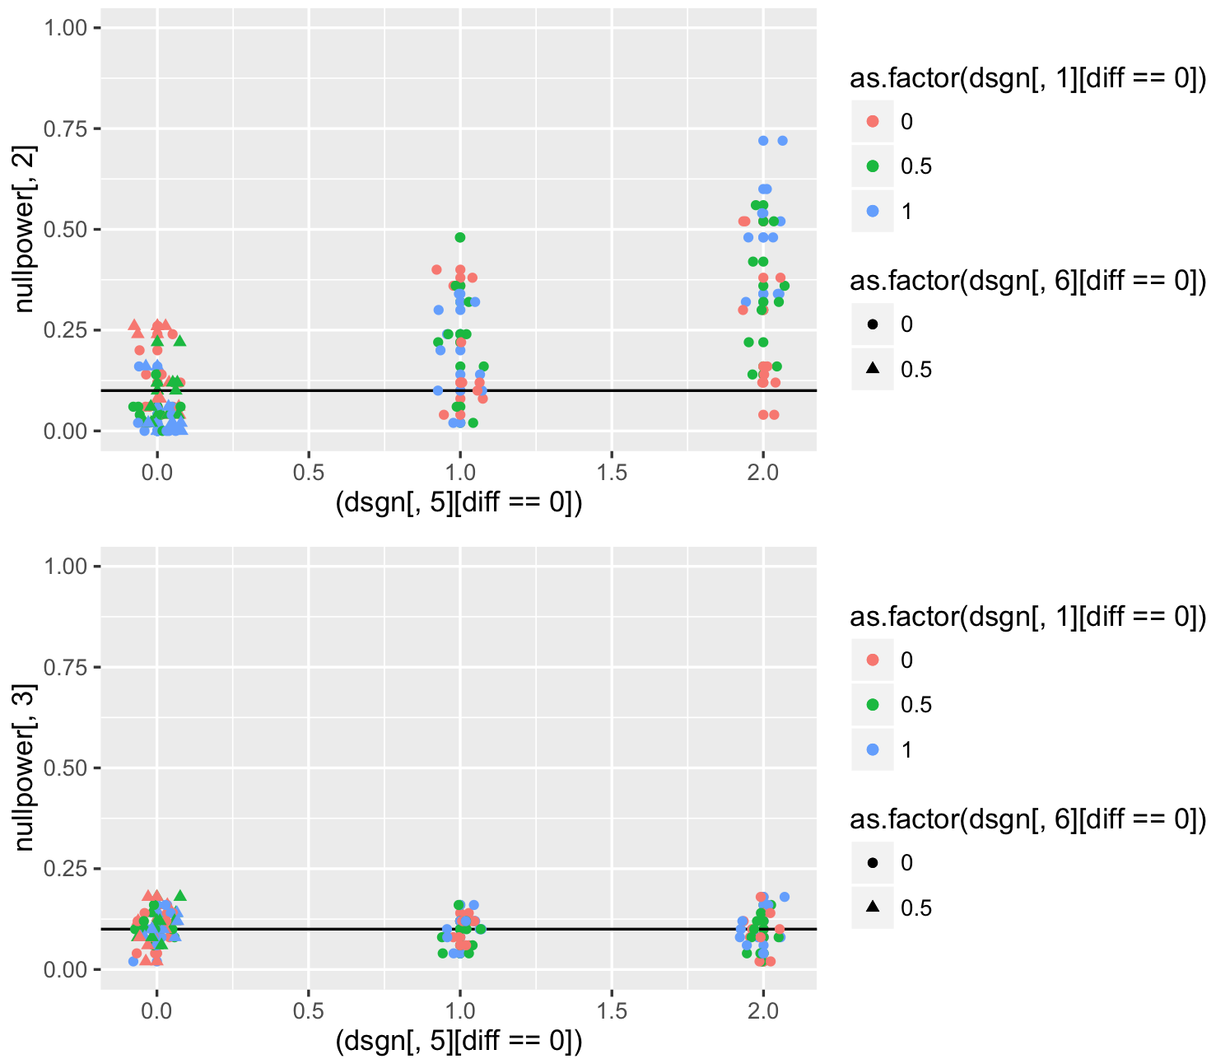

Slide 17
H
Y₁
Y₂
θ₃
θ₇
θ₃
θ₂
θ₅
θ₂
X₁
X₂
θ₁₁
θ₅
θ₆
θ₁
θ₁
C₁
C₂
Z
θ₄

Slide 18
Unless you condition on Y1, theta2 becomes a big problem when theta5 is high and theta 6 =0.
lvls[[1]] <- c(0) # violation
lvls[[2]] <- c(0, 0.5, 1, 6)
lvls[[3]] <- c(0)
lvls[[4]] <- c(0,0.5,1)
lvls[[5]] <- c(0, 1, 5)
lvls[[6]] <-c(0, 0.5)
lvls[[7]] <- c(0) # violation
lvls[[8]] <- c(0)
lvls[[9]] <- c(0)
lvls[[10]] <- c(0)
lvls[[11]] <- c(0, 1, 6)

Slide 19
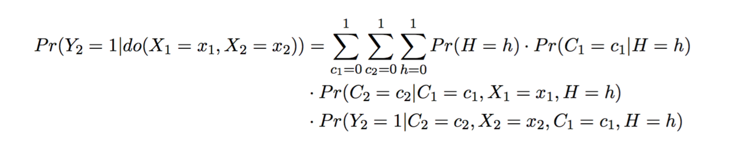
Unless you condition on Y1, theta2 becomes a big problem when theta5 is high and theta 6 =0.
H
Y₁
Y₂
θ₂
θ₅
θ₂
X₁
X₂
θ₁₁
θ₅
C₁
C₂
θ₄
Conditioning on H is the problem

Slide 20
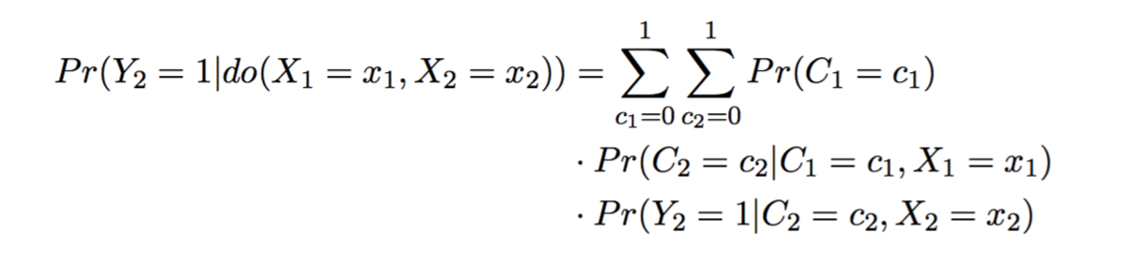

Slide 21
lvls[[1]] <- c(0) # violation
lvls[[2]] <- c(0, 0.5, 1, 6)
lvls[[3]] <- c(0)
lvls[[4]] <- c(0,0.5,1)
lvls[[5]] <- c(0, 1, 5)
lvls[[6]] <-c(0, 0.5)
lvls[[7]] <- c(0) # violation
lvls[[8]] <- c(0)
lvls[[9]] <- c(0)
lvls[[10]] <- c(0)
lvls[[11]] <- c(0, 1, 6)

Slide 22
The G-computation method is another approach, which is
related to the traditional regression adjustment approach. A regression
model for the mean outcome is fit with treatment indicator
and risk factors (or just the propensity score) as covariates.

